Slide 1
Explaining Cronbach’s Alpha
Kirk Allen
Graduate Research Assistant
kcallen@ou.edu
University of Oklahoma
Dept. of Industrial Engineering

Slide 2
What is alpha and why should we care?
  Cronbach’s alpha is the most commonly used measure of reliability (i.e., internal consistency).
  It was originally derived by Kuder & Richardson (1937) for dichotomously scored data (0 or 1) and later generalized by Cronbach (1951) to account for any scoring method.
  People know that a high alpha is good, but it is important to have a deeper knowledge to use it properly. That is the purpose of this presentation.

Slide 3
Other types of reliability
  Test/Re-Test
    The same test is taken twice.
  Equivalent Forms
    Different tests covering the same topics
    Can be accomplished by splitting a test into halves

Slide 4
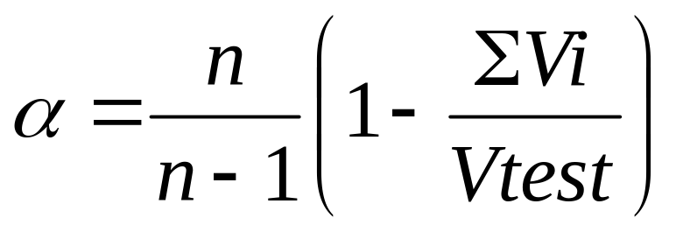
Cronbach’s basic equation for alpha
  n = number of questions
  Vi = variance of scores on each question
  Vtest = total variance of overall scores (not %’s) on the entire test

Slide 5
How alpha works
  V_{i} = p_{i} * (1-p_{i})
    p_{i} = percentage of class who answers correctly
    This formula can be derived from the standard definition of variance.
  V_{i} varies from 0 to 0.25
p_{i} | 1-p_{i} | V_{i}
0 | 1 | 0
0.25 | 0.75 | 0.1875
0.5 | 0.5 | 0.25

Slide 6
How alpha works
  Vtest is the most important part of alpha
  If Vtest is large, it can be seen that alpha will be large also:
    Large Vtest → Small Ratio ΣVi/Vtest → Subtract this small ratio from 1 → high alpha

Slide 7
High alpha is good. High alpha is caused by high variance.
But why is high variance good?
  High variance means you have a wide spread of scores, which means students are easier to differentiate.
  If a test has a low variance, the scores for the class are close together. Unless the students truly are close in ability, the test is not useful.

Slide 8
What makes a question “Good” or “Bad” in terms of alpha?
  SPSS and SAS will report “alpha if item deleted”, which shows how alpha would change if that one question was not on the test.
  Low “alpha if item deleted” means a question is good because deleting that question would lower the overall alpha.
  In a test such as the SCI (34 items), no one question will have a large deviation from the overall alpha.
    Usually at most 0.03 in either direction

Slide 9
What causes a question to be “Bad”?
Questions with high “alpha if deleted” tend to have low inter-item correlations (Pearson’s r).

Slide 10
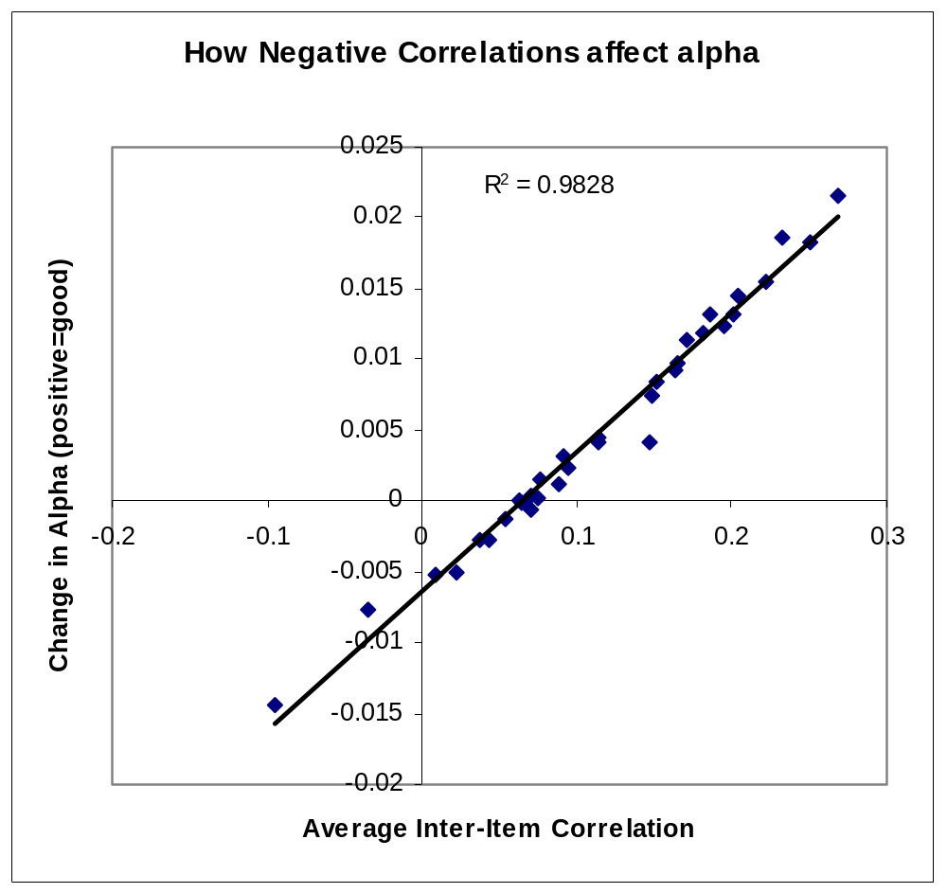

Slide 11
What causes low or negative inter-item correlations?
  When a question tends to be answered correctly by students who have low overall scores on the test, but the question is missed by people with high overall scores.
  The “wrong” people are getting the question correct.
Quantified by the “gap” between correct and incorrect students
  Correct students: average score 15.0
  Incorrect students: average score 12.5
  Gap = 15.0 – 12.5 = 2.5

Slide 12
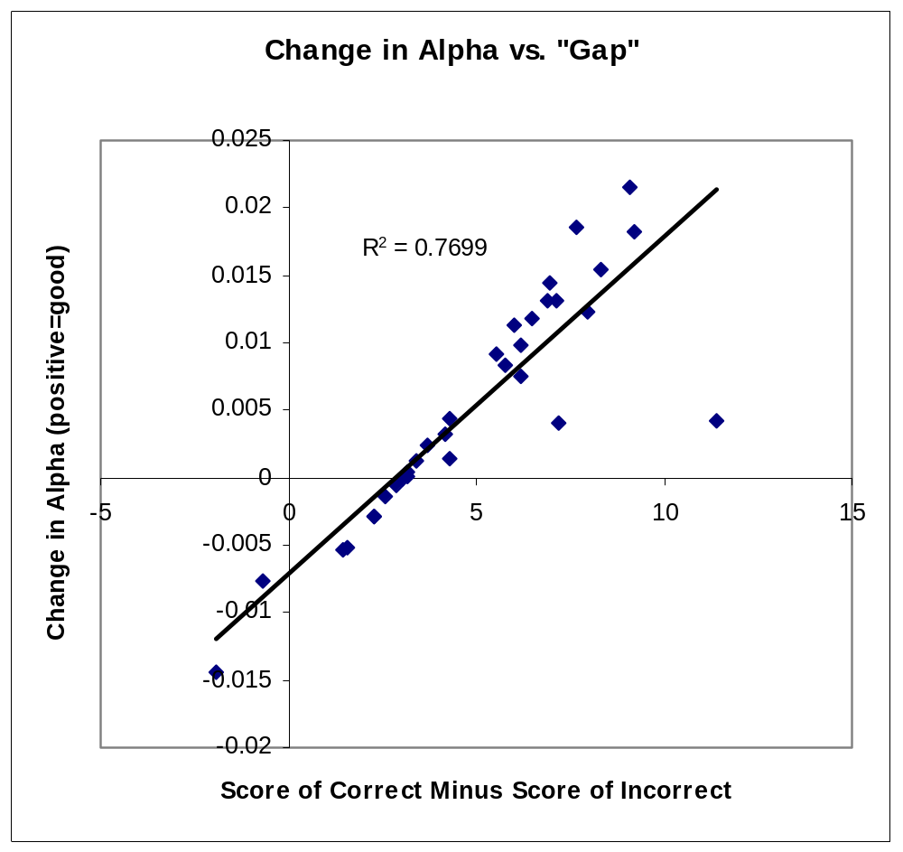

Slide 13
If a question is “bad”, this means it is not conforming with the rest of the test to measure the same basic factor (e.g., statistics knowledge).
  The question is not “internally consistent” with the rest of the test.
Possible causes (based on focus group comments)
  Students are guessing (e.g., question is too hard).
  Students use test-taking tricks (e.g., correct answer looks different from incorrect answers).
  Question requires a skill that is different from the rest of the questions (e.g., memory recall of a definition).

Slide 14
How does test length “inflate” alpha?
For example, consider doubling the test length:
  Vtest will increase by a power of 4 because variance involves a squared term.
  However, ΣVi will only double because each Vi is just a number between 0 and 0.25.
  Since Vtest increases faster than ΣVi (recall that high Vtest is good), then alpha will increase by virtue of lengthening the test.

Slide 15
References
Kuder & Richardson, 1937, “The Theory of the Estimation of Test Reliability” (Psychometrika v. 2 no. 3)
Cronbach, 1951, “Coefficient Alpha and the Internal Structure of Tests” (Psychometrika v. 16 no. 3)
Cortina, 1993, “What is coefficient alpha? An examination of theory and applications” (J. of Applied Psych. v. 78 no. 1 p. 98-104)
Streiner, 2003, “Starting at the Beginning: An Introduction to Coefficient Alpha and Internal Consistency” (J. of Personality Assessment v. 80 no. 1 p. 99-103)

